Slide 1
Digital Logic Design
Lecture 01- 05

Slide 2
Digital and Analog Quantities
Most natural quantities that we see are analog and vary continuously. Analog systems can generally handle higher power than digital systems. Digital systems can process, store, and transmit data more efficiently but can only assign discrete values to each point.
Many systems use a mix of analog and digital electronics to take advantage of each technology. A typical CD player accepts digital data from the CD drive and converts it to an analog signal for amplification
Digital electronics involves quantities with discrete values, and analog electronics involves quantities with continuous values. A digital quantity is one having a discrete set of values. Most things that can be measured quantitatively occur in nature in analog form.

Slide 3
Digital and Analog Quantities
Analog and digital signals are the types of signals carrying information. The major difference between both signals is that the analog signals have continuous electrical signals, while digital signals have non-continuous electrical signals.
Digital circuits are more reliable. Digital circuits are easy to design and cheaper than analog circuits. The hardware implementation in digital circuits, is more flexible than analog. The occurrence of cross-talk is very rare in digital communication

Slide 4
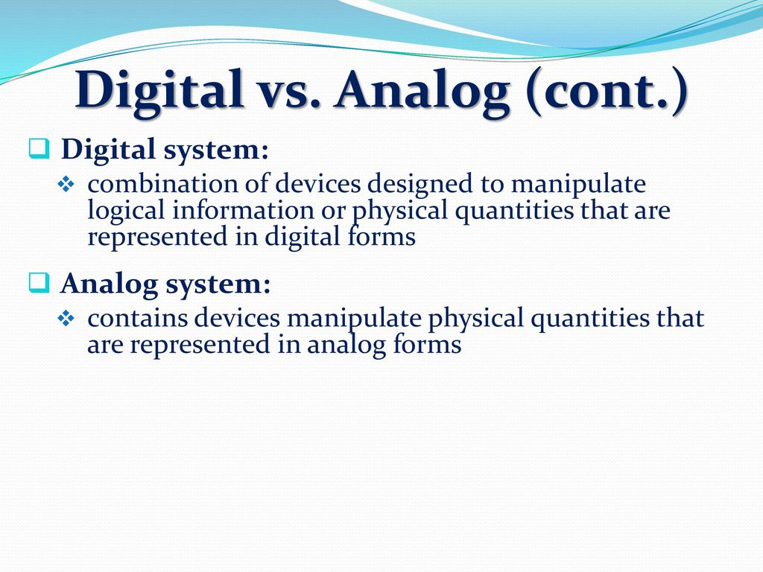
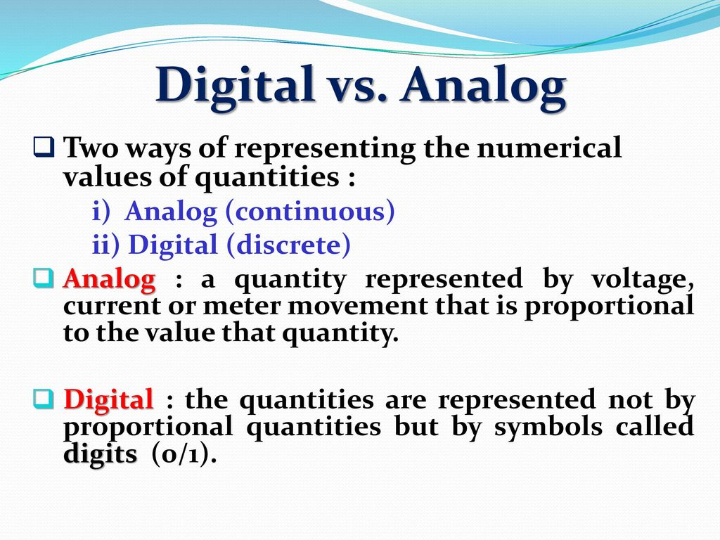

Slide 5
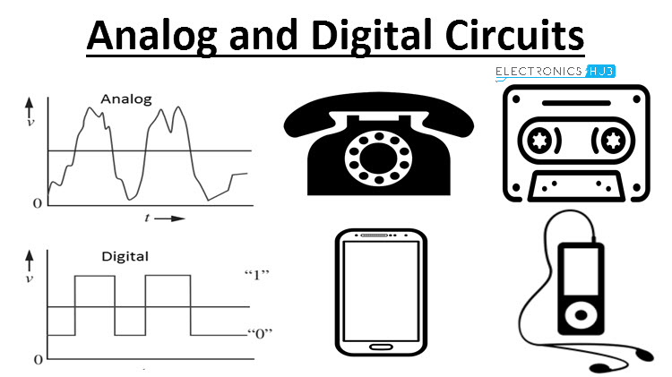
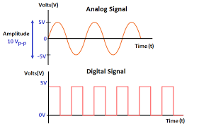
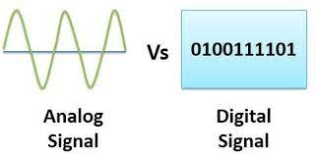
Digital and Analog Quantities

Slide 6
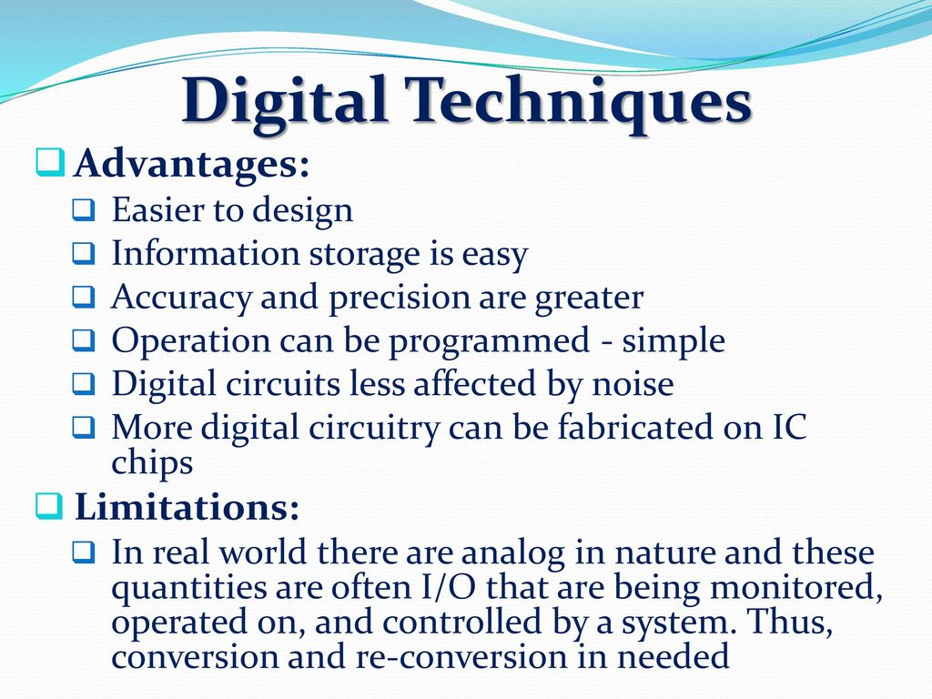
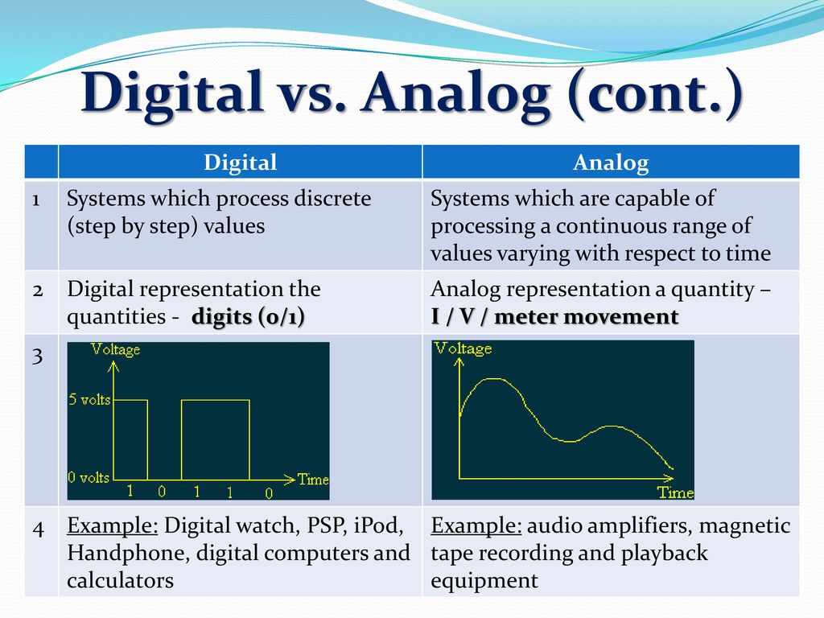

Slide 7
Digital and Analog Quantities
Analog Quantities
Digital Quantities
photocopiers.
old land-line telephones.
audio tapes.
old televisions (intensity and color information per scan line)
VCRs (same as TV)
time, temperature, pressure, distance, and sound
Computers,
CDs,
DVDs
Smart Phones
The analog signal bandwidth is low | The digital signal bandwidth is high.

Slide 8
Binary Digits, Logic Levels, and Digital
Because there are only two valid Boolean values for representing either a logic “1” or a logic “0”, makes the system of using Binary Numbers ideal for use in digital or electronic circuits and systems
In digital systems theses voltages are called “logic levels” and ideally one voltage level represents a “HIGH” state, while another different and lower voltage level represents a “LOW” state. A binary number system uses both of these two states

Slide 9
Binary Digits, Logic Levels, and Digital
Digital electronics uses circuits that have two states, which are represented by two different voltage levels called HIGH and LOW.
The voltages represent numbers in the binary system.
VH(max)In binary, a single number is called a bit (for binary digit).
A bit can have the value of either a 0 or a 1, depending on if the voltage is HIGH or LOW.
HIGH VH(min)
Invalid VL(max)
LOW VL(min)

Slide 10
Waveforms
Digital waveforms change between the LOW and HIGH levels. A positive going pulse is one that goes from a normally LOW logic level to a HIGH level and then back again. Digital waveforms are made up of a series of pulses.
Actual pulses are not ideal but are described by the rise time, fall time, amplitude, and other characteristics.
Periodic pulse waveforms are composed of pulses that repeats in a fixed interval called the period. The frequency is the rate it repeats and is measured in hertz. The clock is a basic timing signal that is an example of a periodic wave.

Slide 11
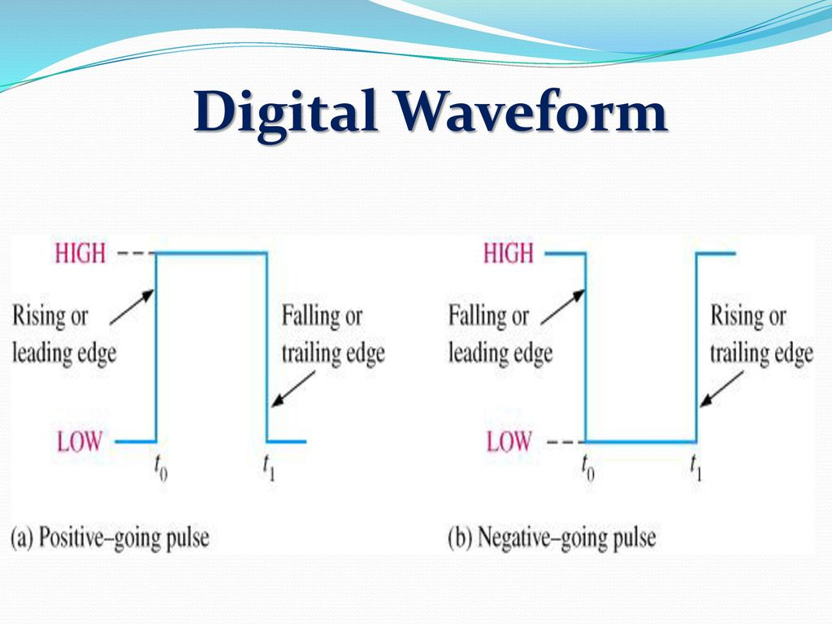
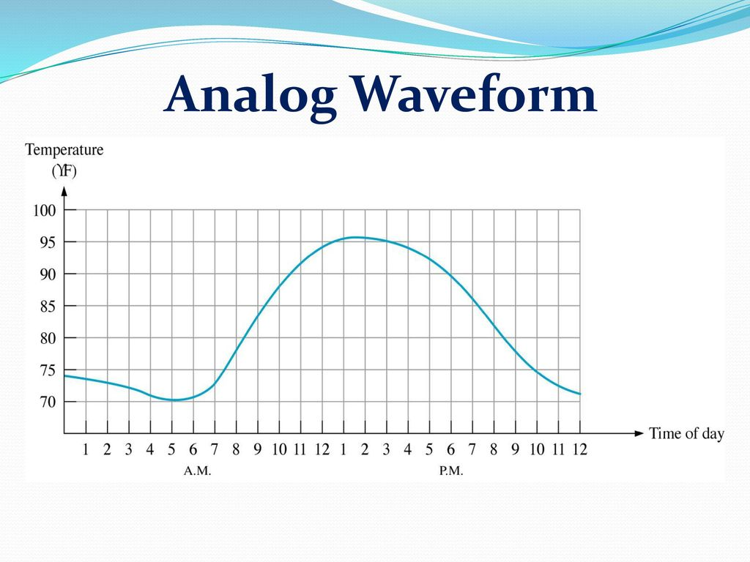

Slide 12
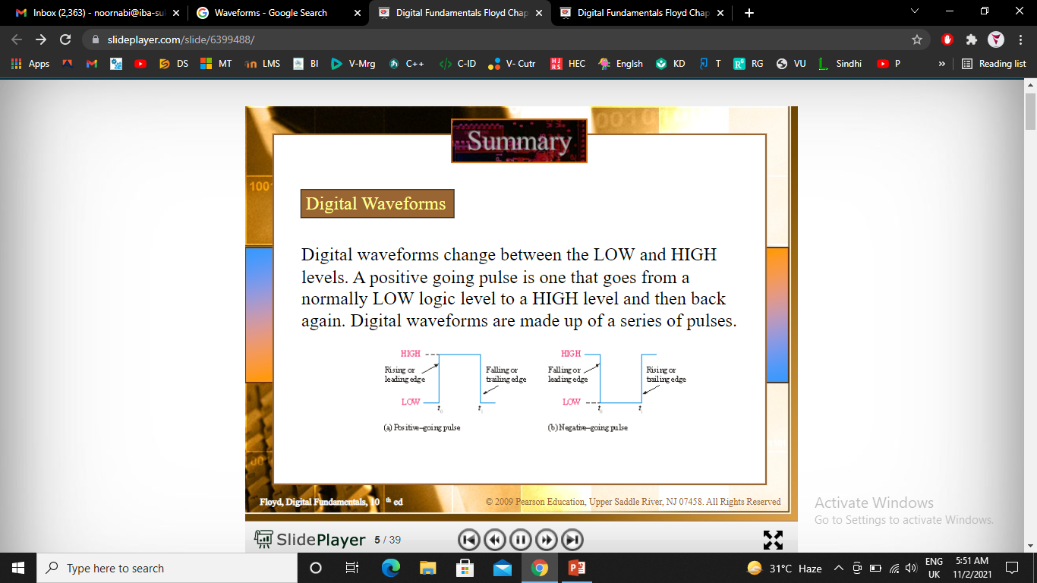

Slide 13
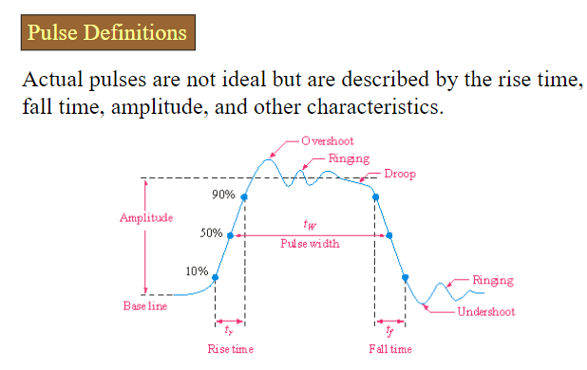

Slide 14
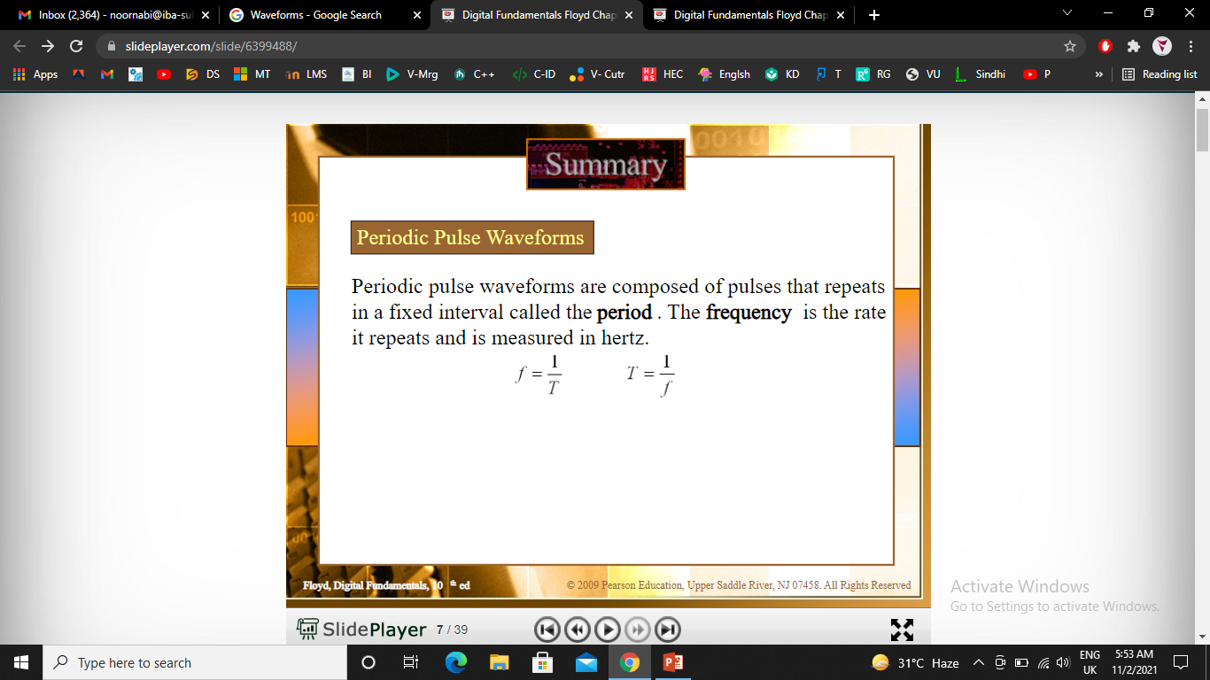

Slide 15
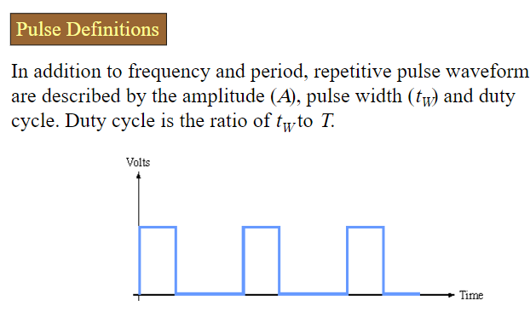

Slide 16
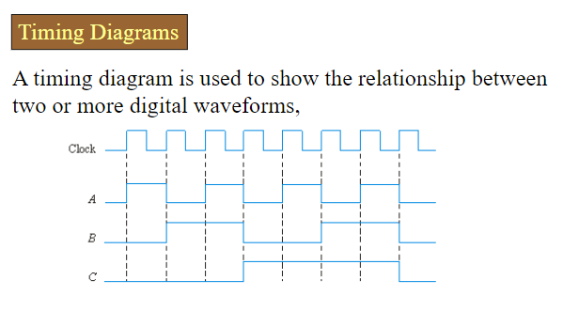

Slide 17
Basic Logic Function
Digital logic has three basic operators, the AND, the OR and the NOT. These three operators form the basis for everything in digital logic. In fact, almost everything your computer does can be described in terms of these three operations

Slide 18
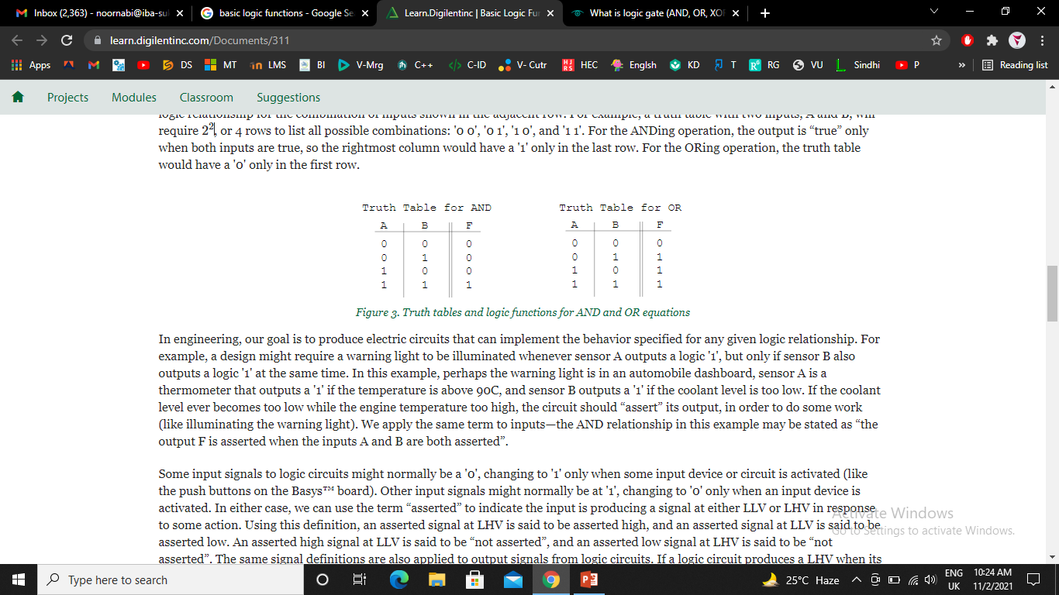
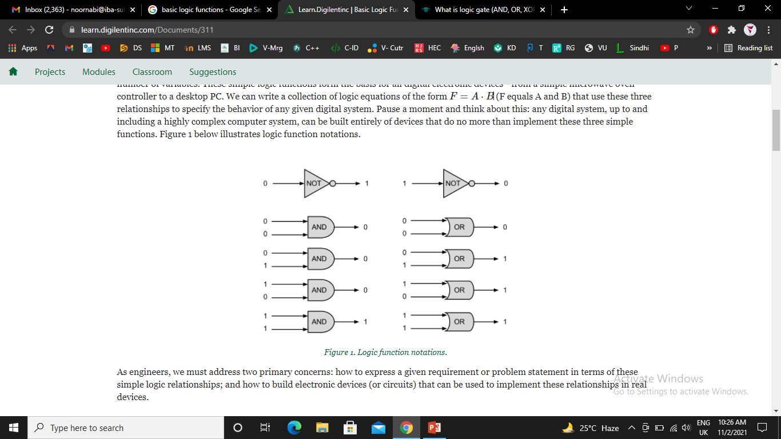

Slide 19
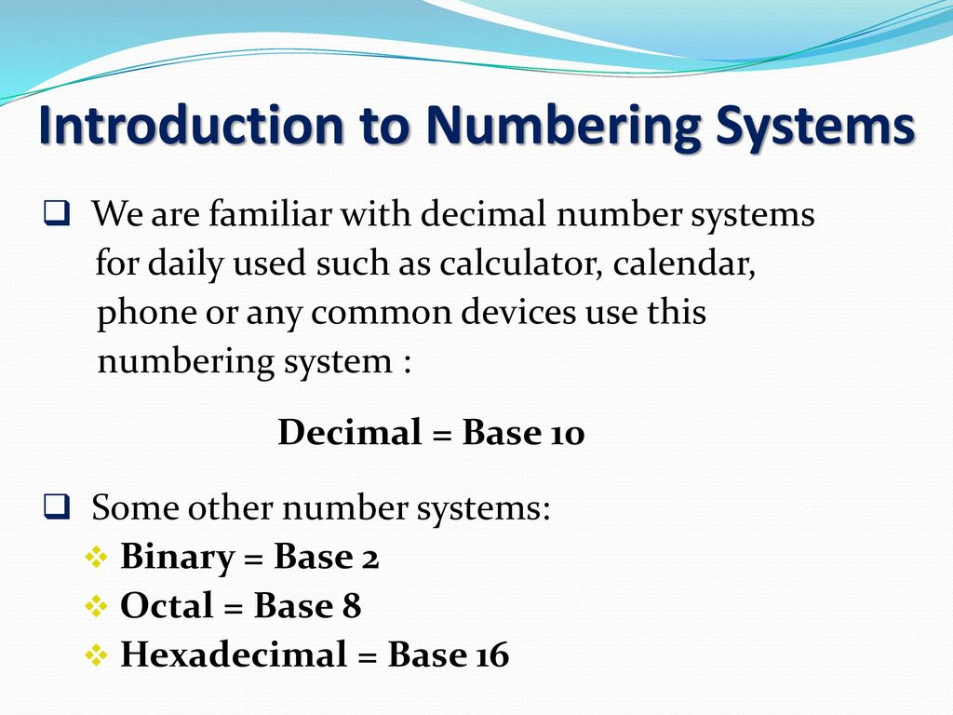
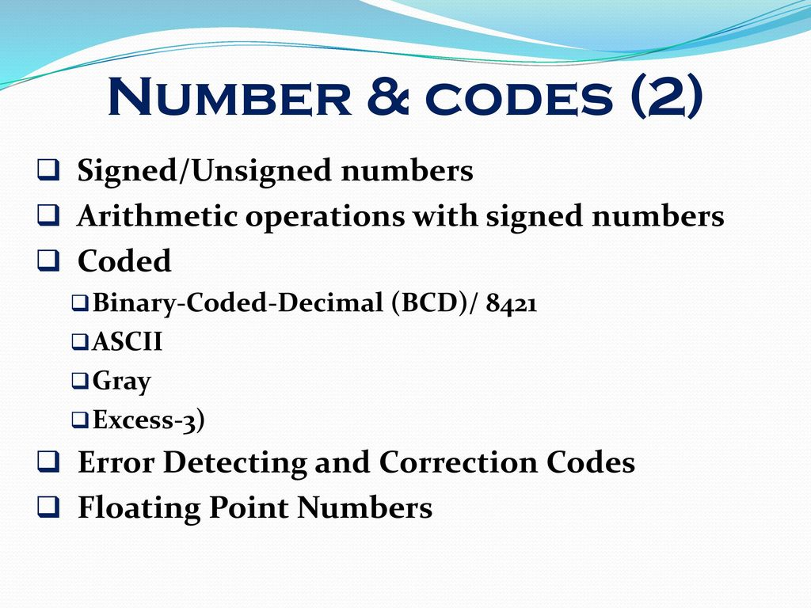

Slide 20
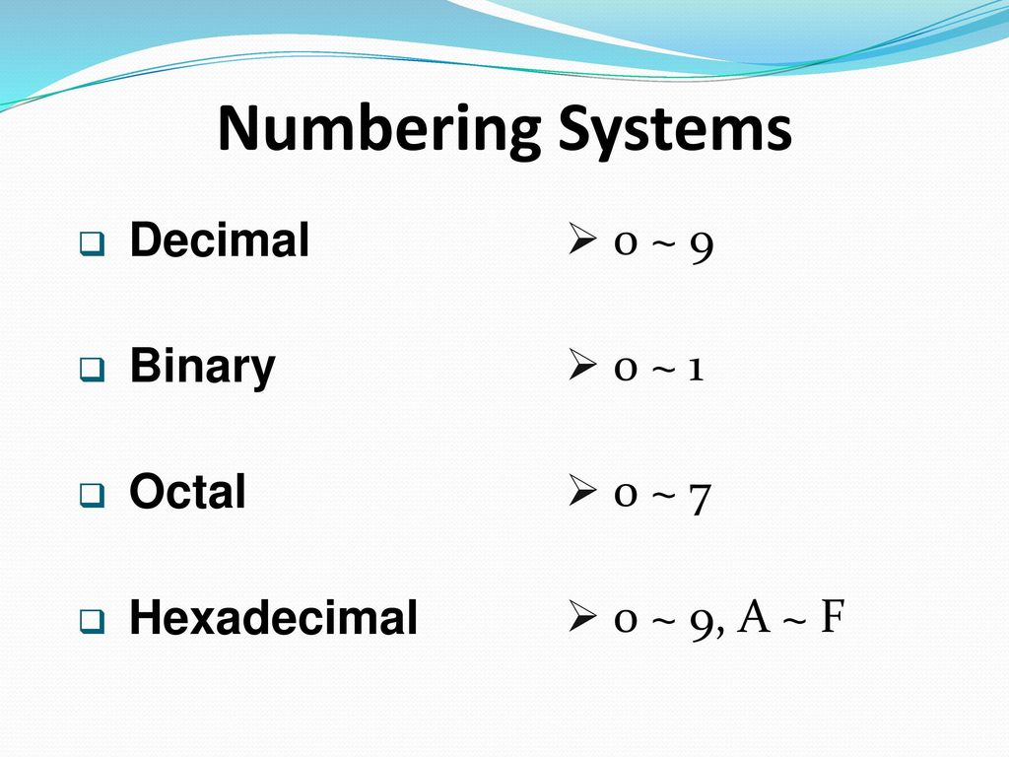
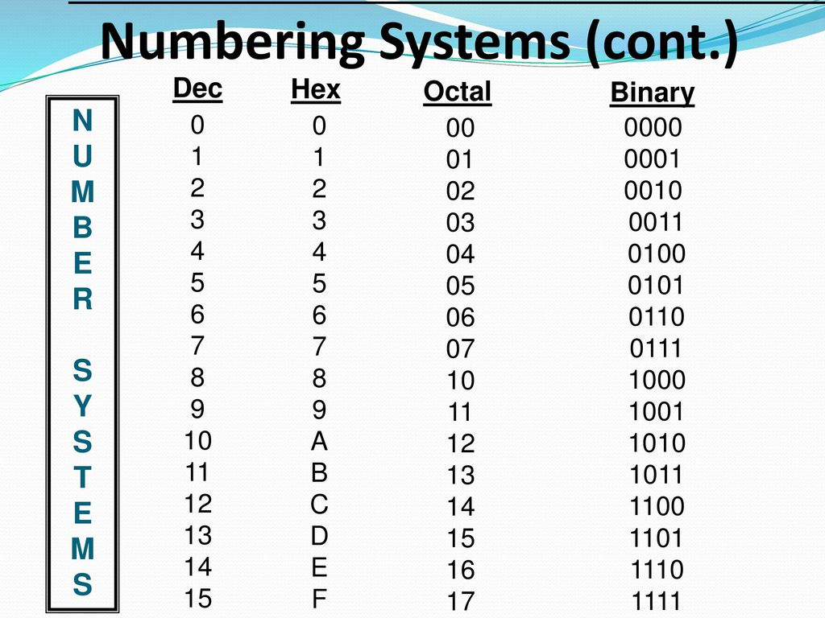

Slide 21
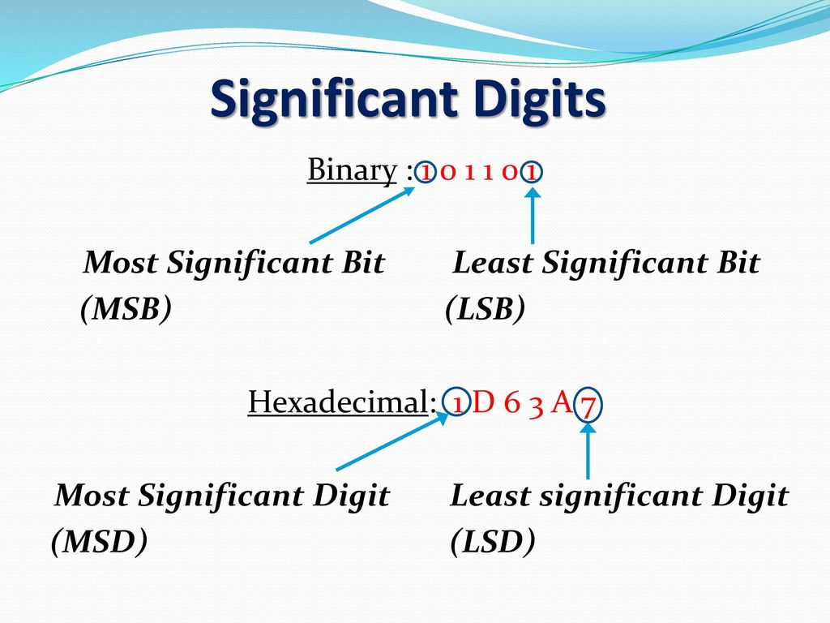
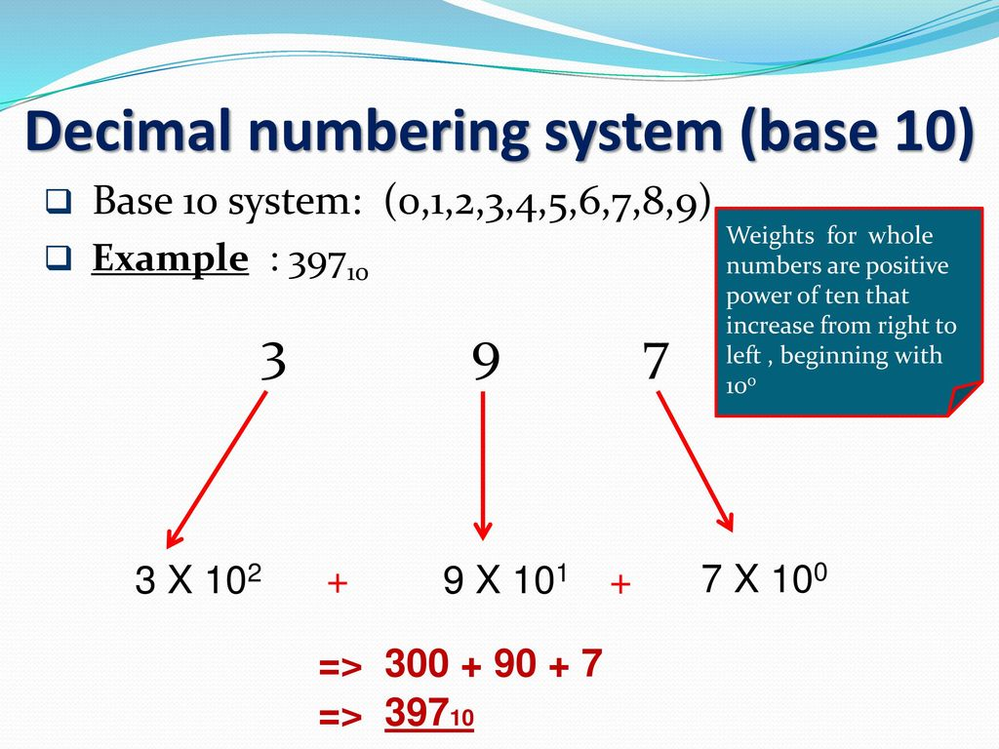

Slide 22
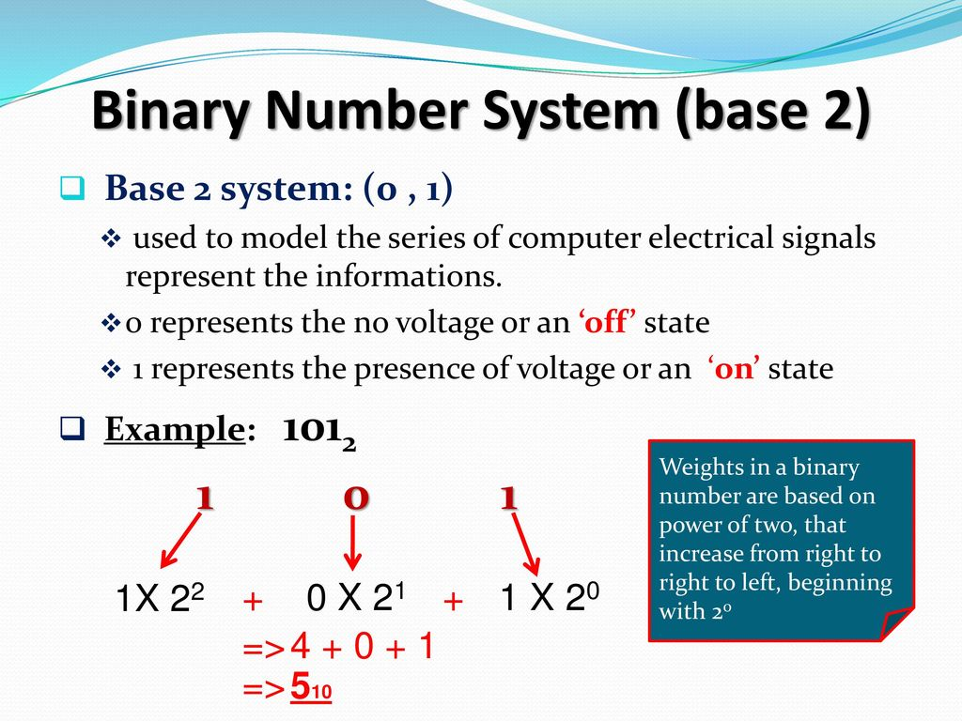
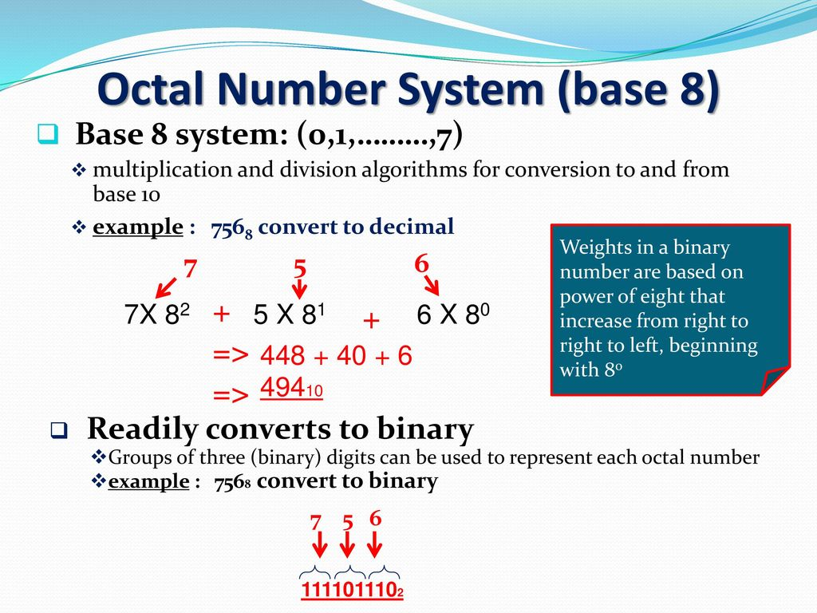

Slide 23
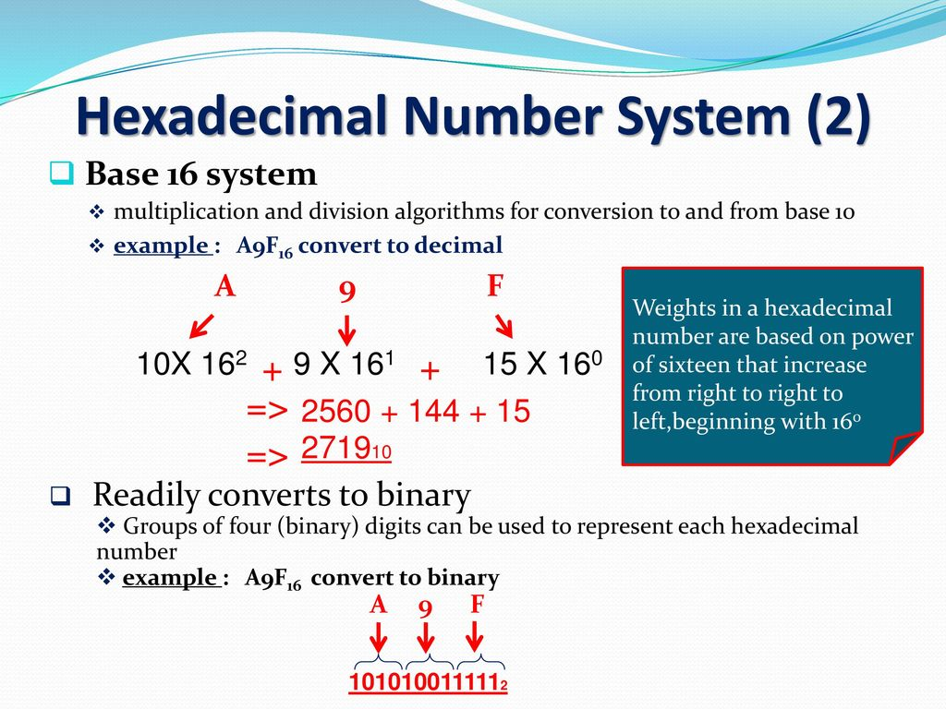
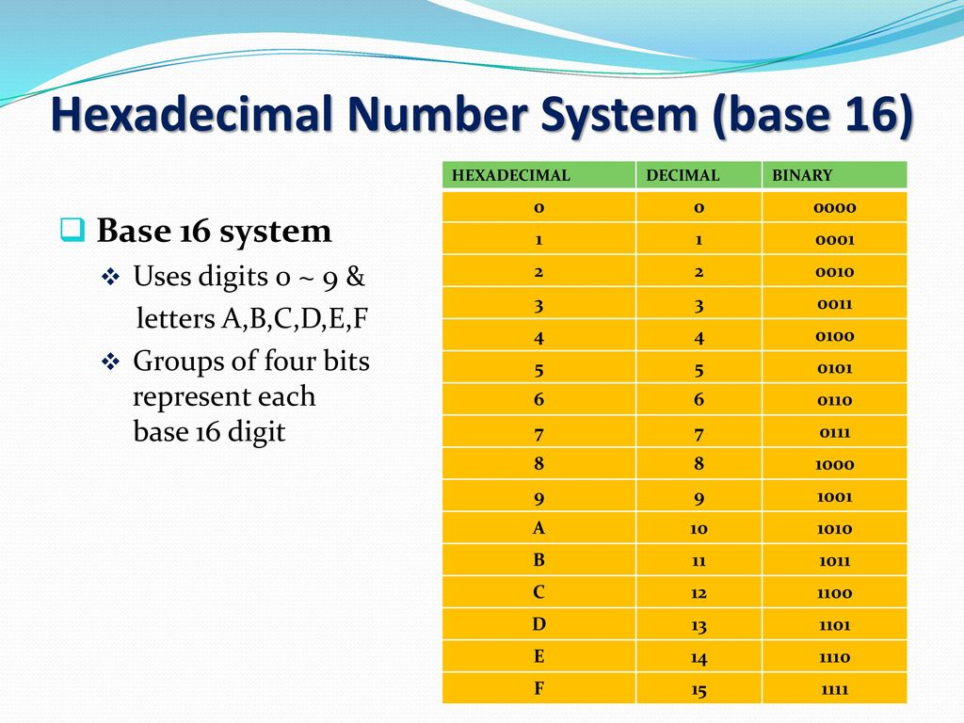

Slide 24
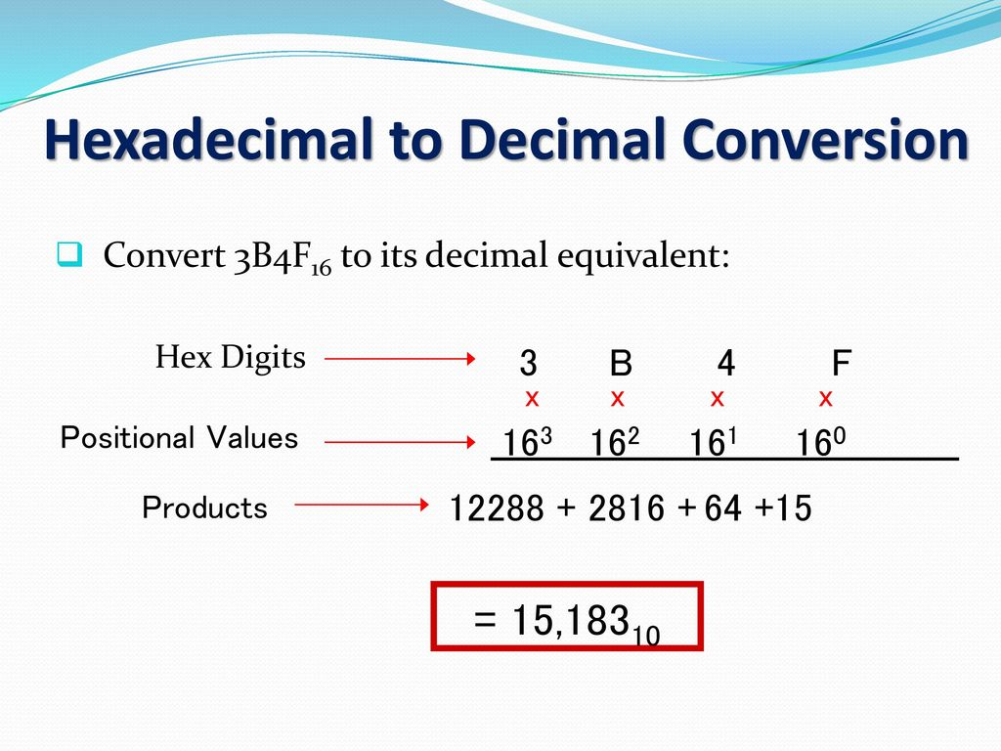
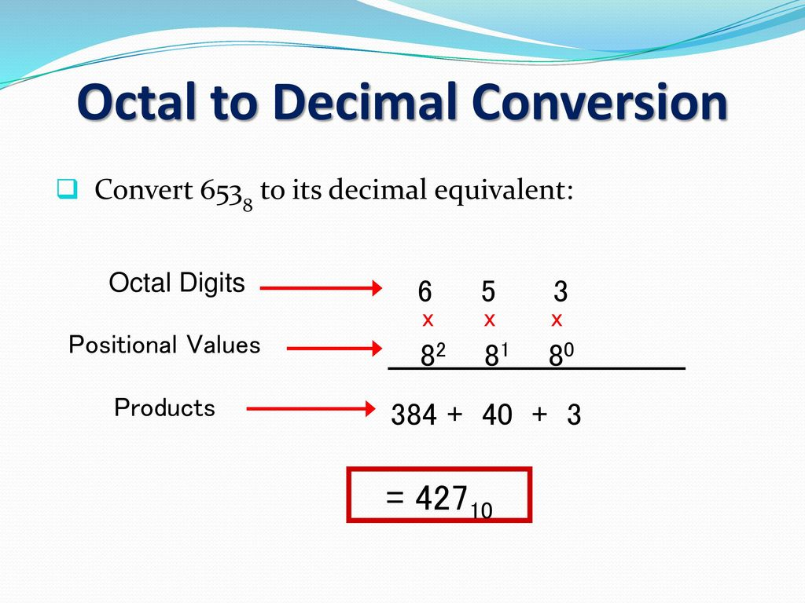

Slide 25
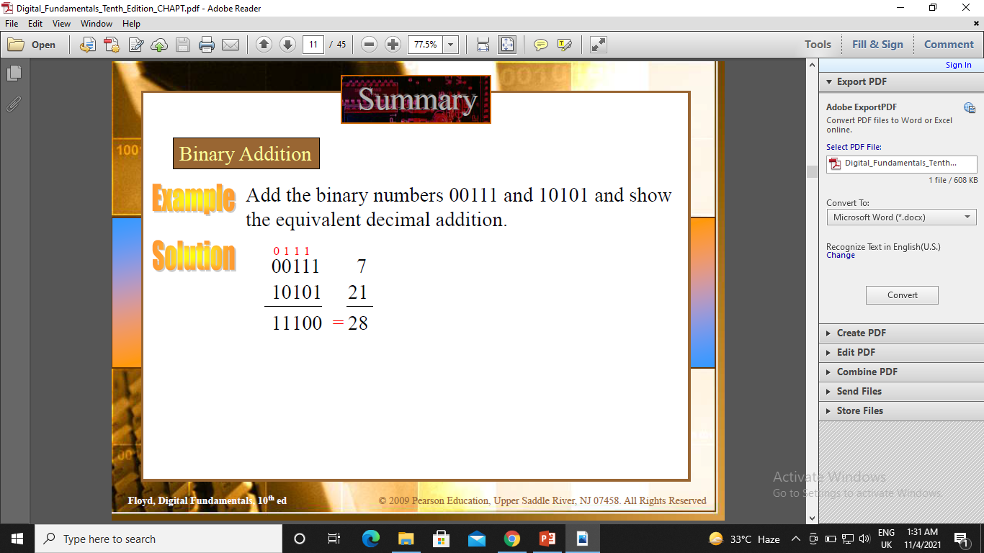
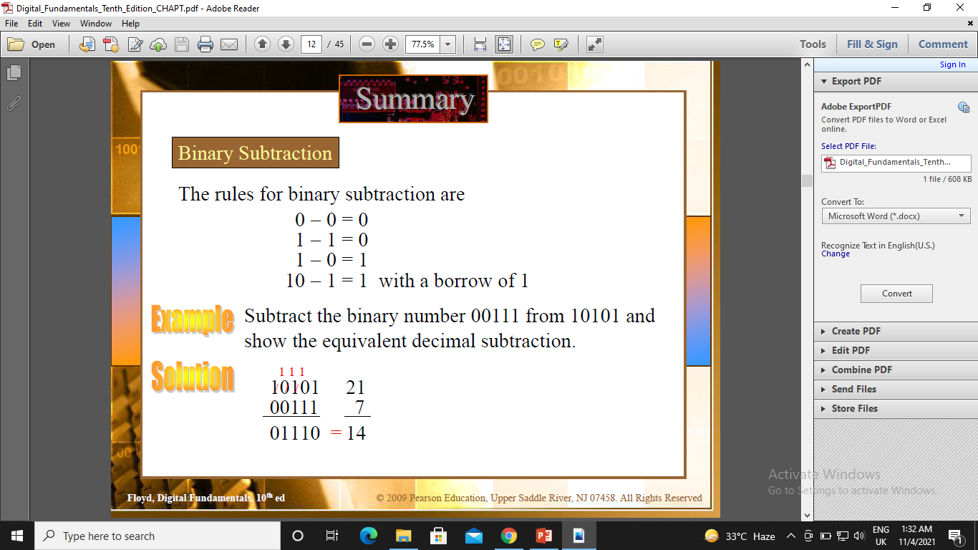
Binary Arithmetic

Slide 26

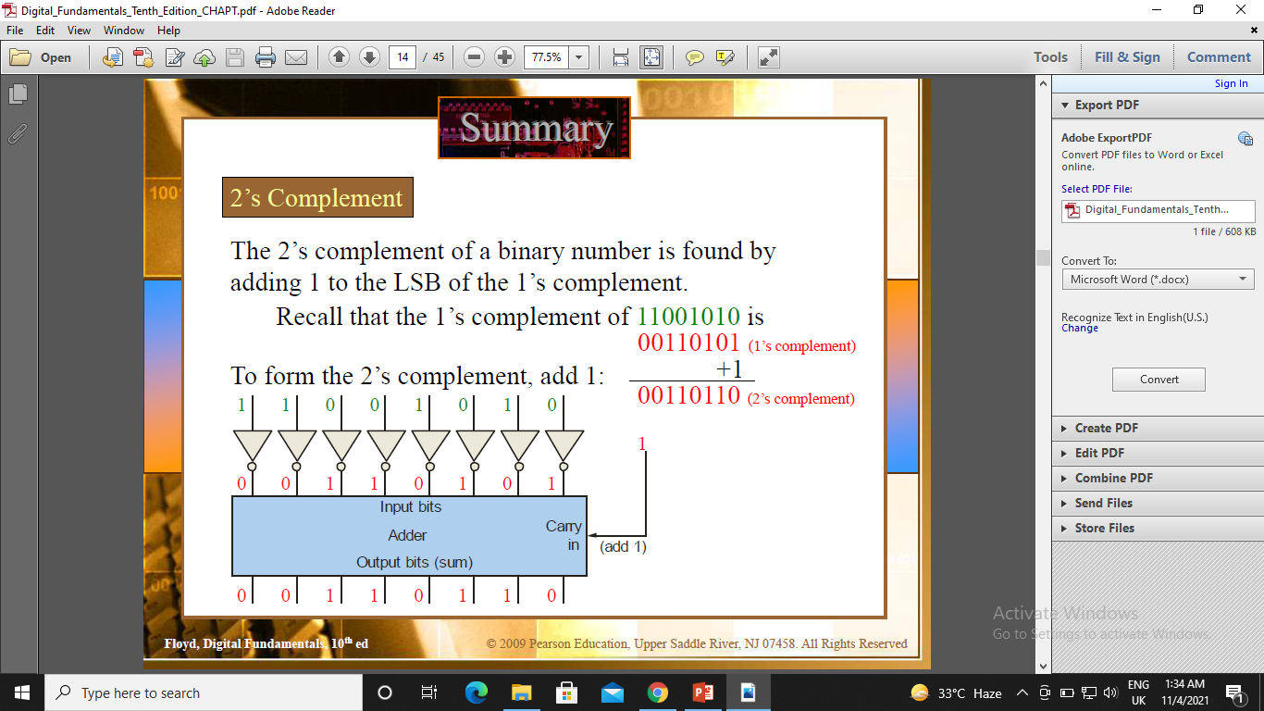
Complements of Binary Numbers

Slide 27
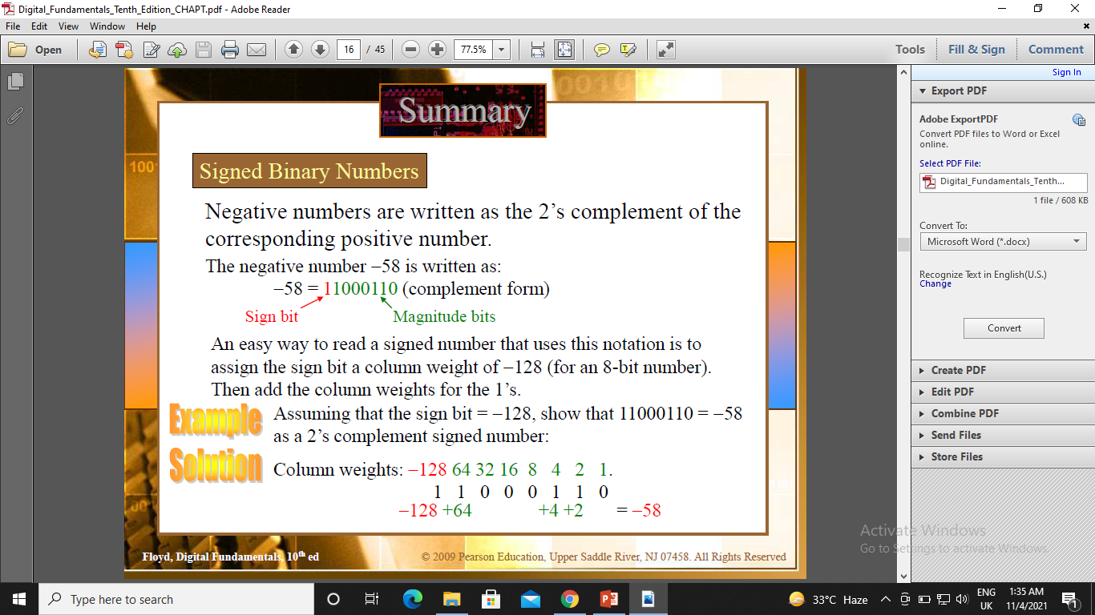
Signed Numbers

Slide 28
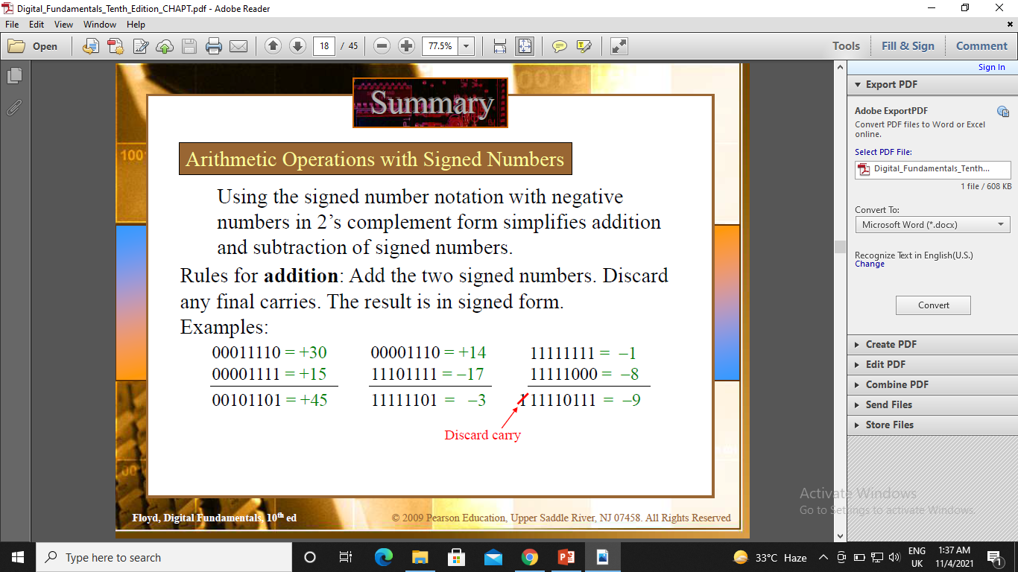
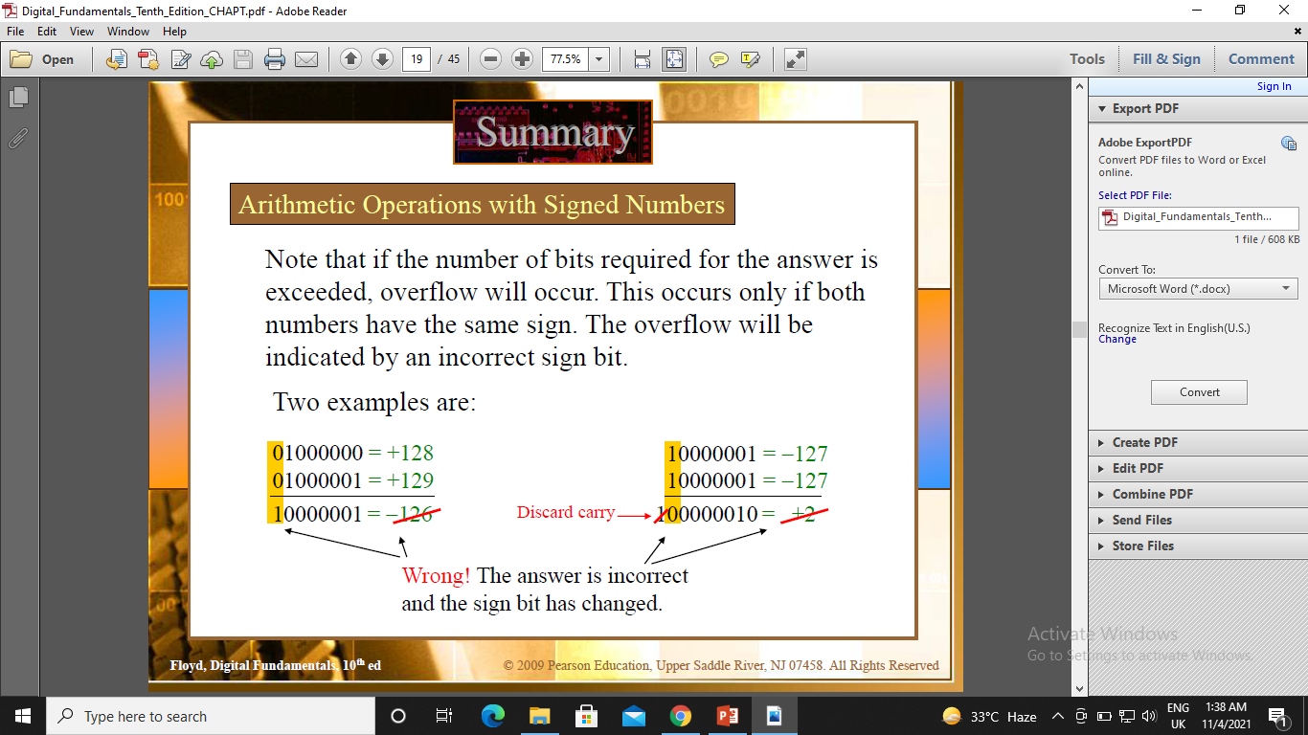
Arithmetic Operations with Signed Numbers

Slide 29
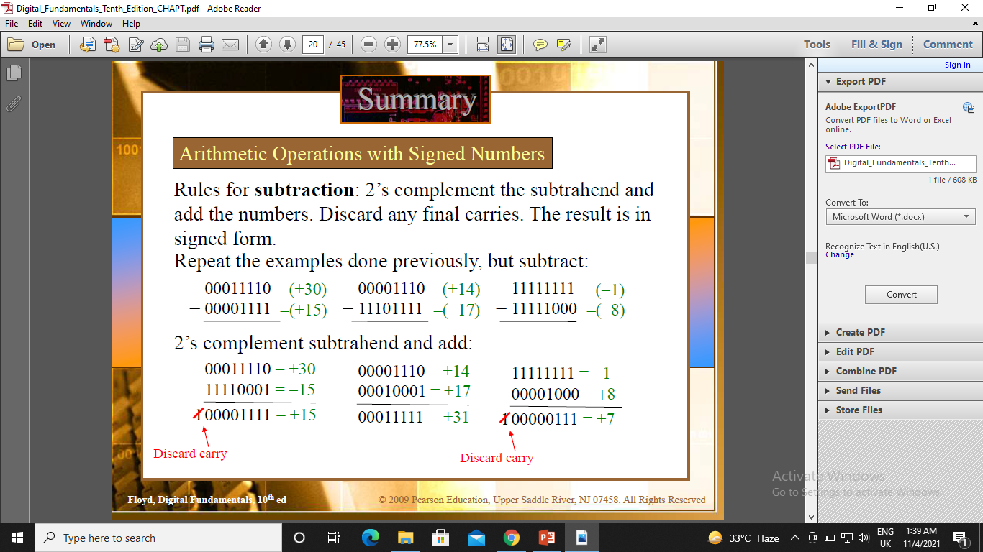

Slide 30
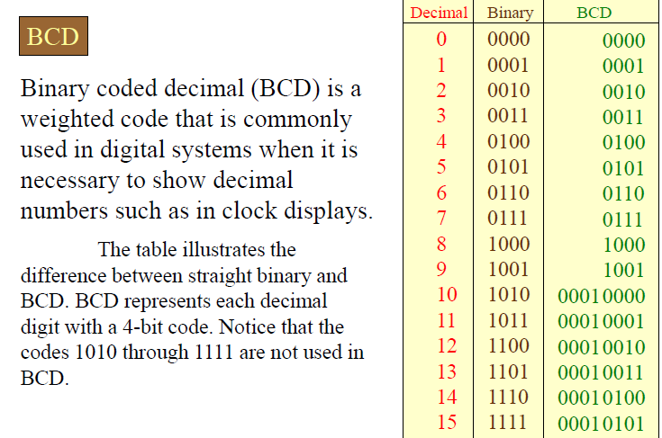
Binary Coded Decimal (BCD)

Slide 31
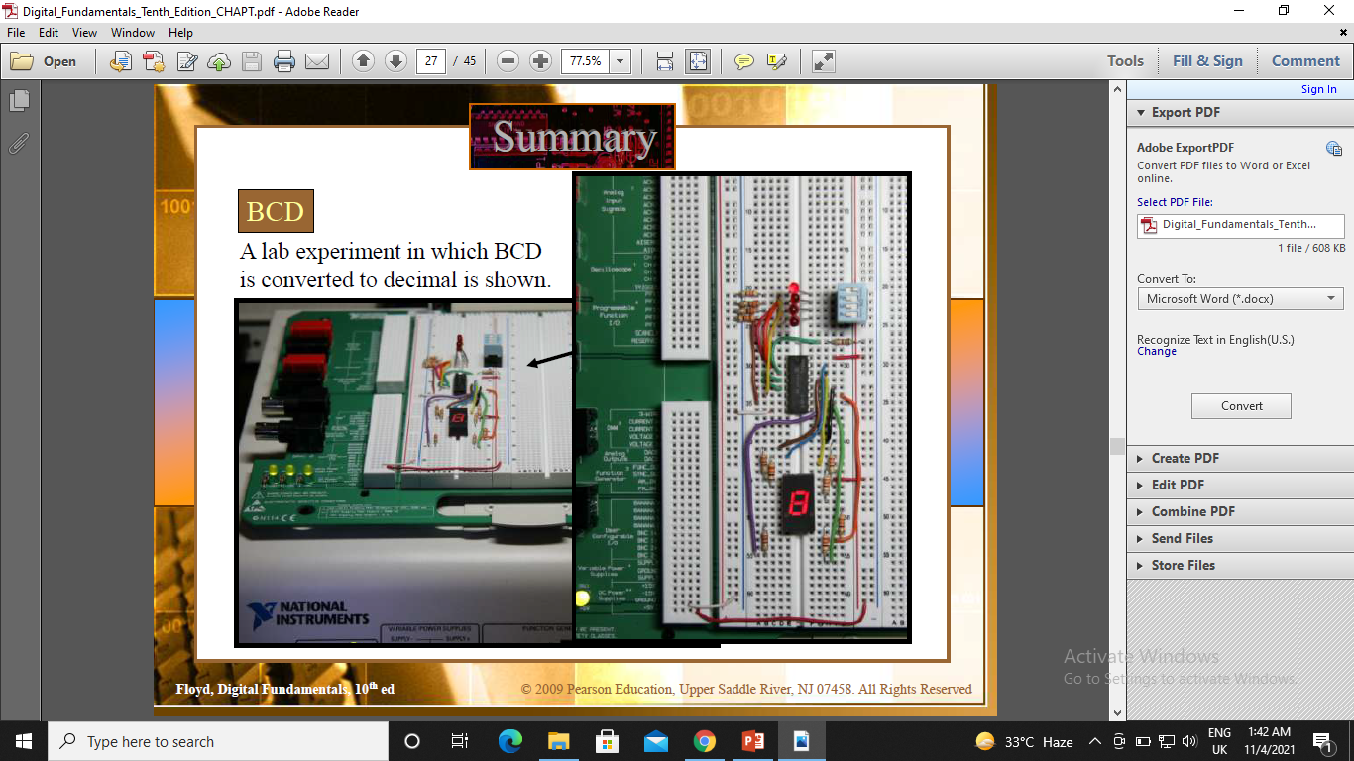

Slide 32
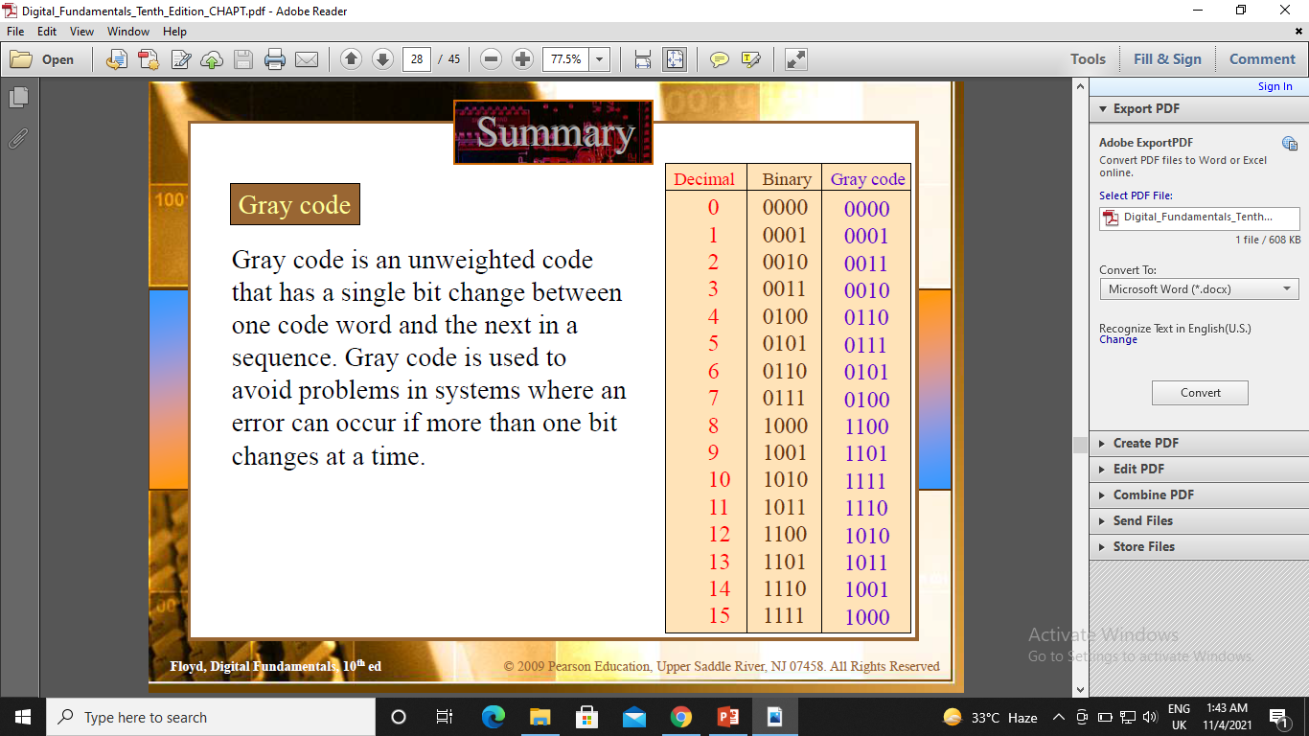
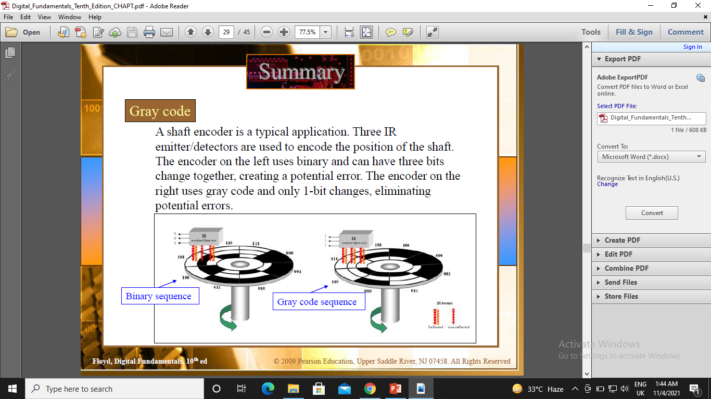
Digital Codes

Slide 33
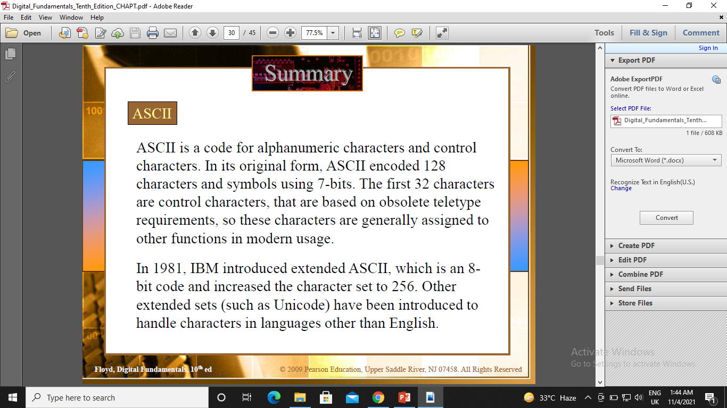

Slide 34
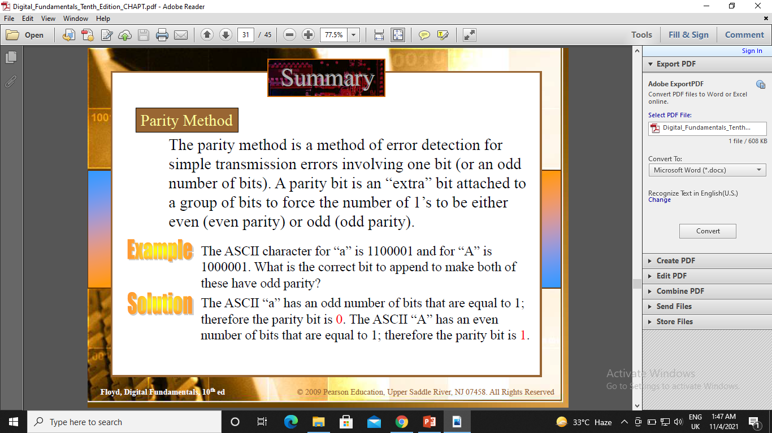
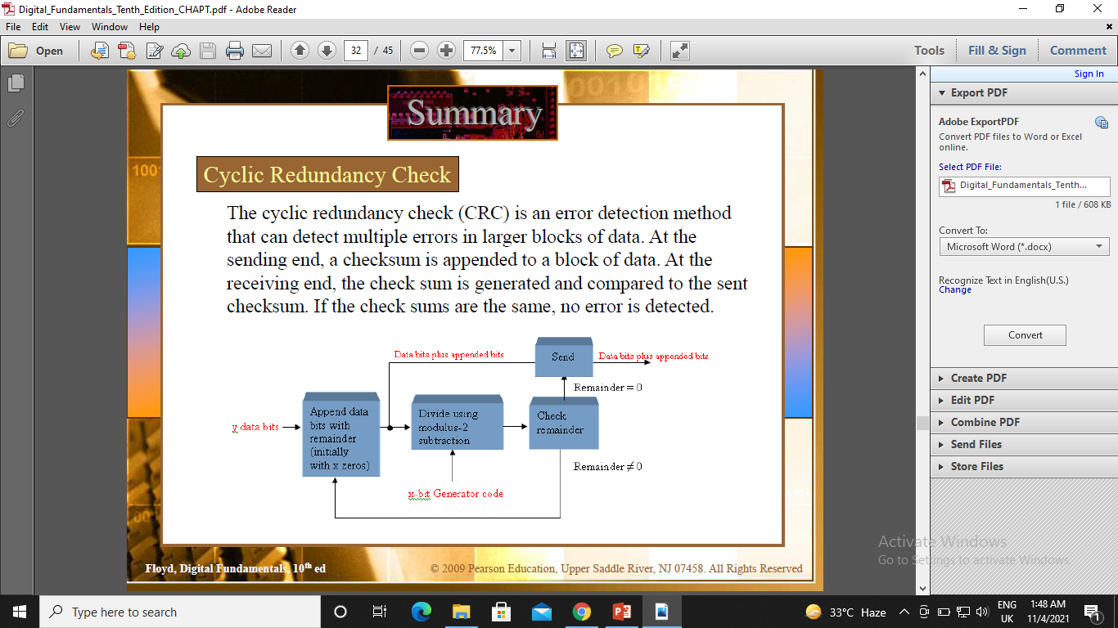
Even and Odd parity

Slide 35
Computers and Electricity
Gate
A device that performs a basic operation on
electrical signals
Circuits
Gates combined to perform more
complicated tasks

Slide 36
Computers and Electricity
How do we describe the behavior of gates and circuits?
Boolean expressions
Uses Boolean algebra, a mathematical notation for expressing two-valued logic
Logic diagrams
A graphical representation of a circuit; each gate has its
own symbol
Truth tables
A table showing all possible input value and the associated
output values

Slide 37
Gates
Six types of gates
NOT
AND
OR
XOR
NAND
NOR
Typically, logic diagrams are black and white with gates distinguished only by their shape

Slide 38
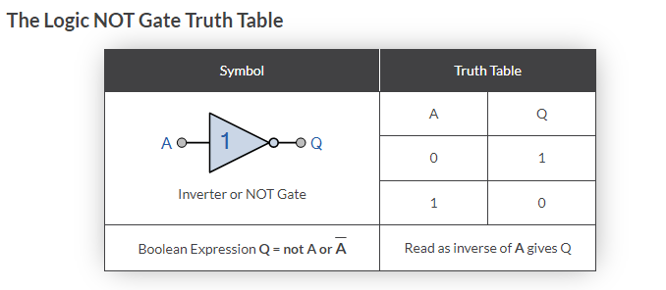
The Inverter
An inverter circuit outputs a voltage representing the opposite logic-level to its input. Its main function is to invert the input signal applied. If the applied input is low then the output becomes high and vice versa.

Slide 39
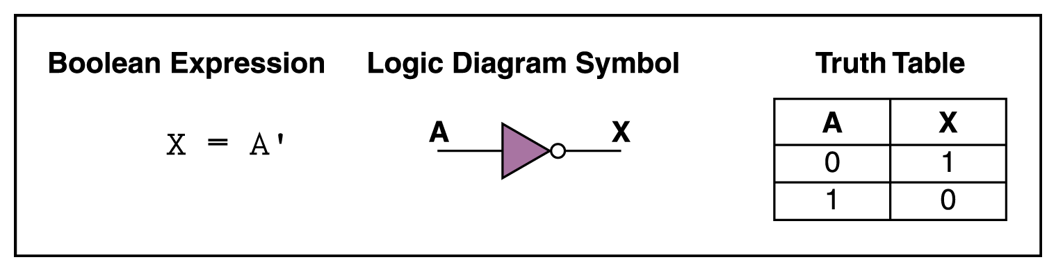
NOT Gate
A NOT gate accepts one input signal (0 or 1) and returns the opposite signal as output
Figure 4.1 Various representations of a NOT gate

Slide 40
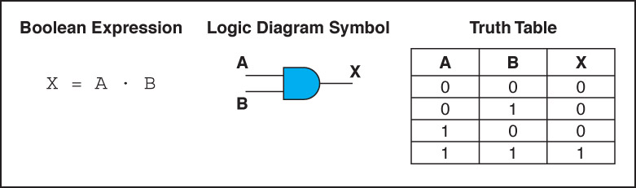
AND Gate
An AND gate accepts two input signals
If both are 1, the output is 1; otherwise,
the output is 0
Figure 4.2 Various representations of an AND gate

Slide 41
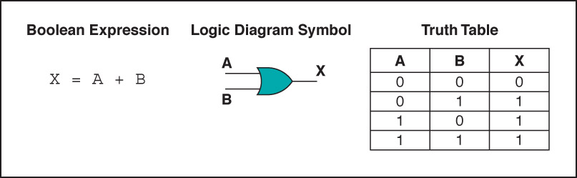
OR Gate
An OR gate accepts two input signals
If both are 0, the output is 0; otherwise,
the output is 1
Figure 4.3 Various representations of a OR gate

Slide 42
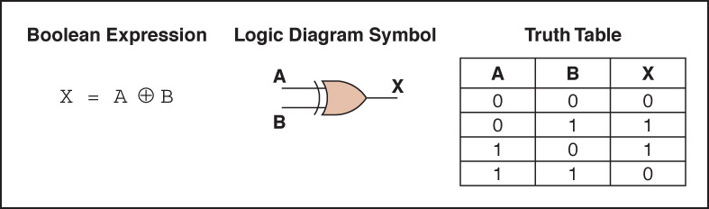
XOR Gate
An XOR gate accepts two input signals
If both are the same, the output is 0; otherwise,
the output is 1
Figure 4.4 Various representations of an XOR gate

Slide 43
XOR Gate
Note the difference between the XOR gate and the OR gate; they differ only in one input situation
When both input signals are 1, the OR gate produces a 1 and the XOR produces a 0
XOR is called the exclusive OR

Slide 44
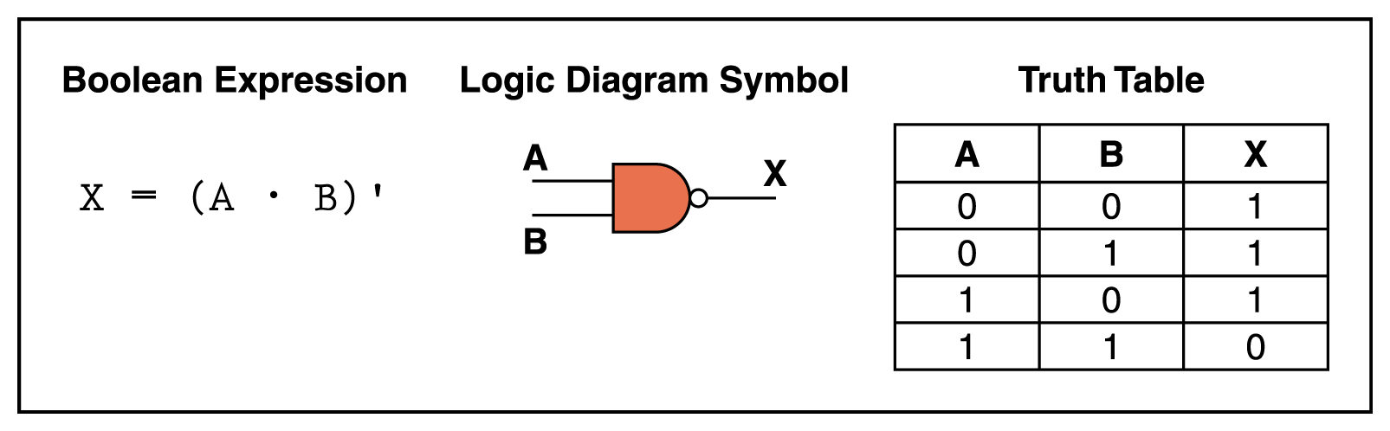
NAND Gate
The NAND gate accepts two input signals
If both are 1, the output is 0; otherwise,
the output is 1
Figure 4.5 Various representations of a NAND gate

Slide 45
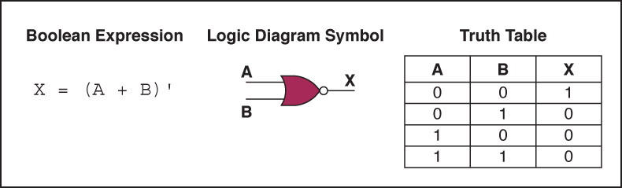
NOR Gate
The NOR gate accepts two input signals
If both are 0, the output is 1; otherwise,
the output is 0
Figure 4.6 Various representations of a NOR gate

Slide 46
Review of Gate Processing
A NOT gate inverts its single input
An AND gate produces 1 if both input values are 1
An OR gate produces 0 if both input values are 0
An XOR gate produces 0 if input values are the same
A NAND gate produces 0 if both inputs are 1
A NOR gate produces a 1 if both inputs are 0

Slide 47
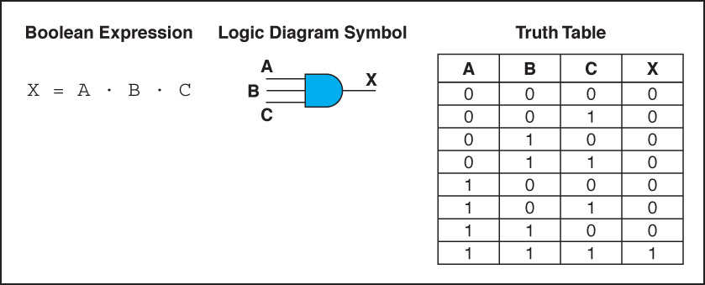
Gates with More Inputs
Gates can be designed to accept three or more input values
A three-input AND gate, for example, produces an output of 1 only if all input values are 1
Figure 4.7 Various representations of a three-input AND gate

Slide 48
Constructing Gates
Transistor
A device that acts either as a wire that conducts electricity or as a resistor that blocks the flow of electricity, depending on the voltage level of an input signal
A transistor has no moving parts, yet acts like a switch
It is made of a semiconductor material, which is neither a particularly good conductor of electricity nor a particularly good insulator

Slide 49

Constructing Gates
A transistor has three terminals
A source
A base
An emitter, typically connected to a ground wire
If the electrical signal is grounded, it is allowed to flow through an alternative route to the ground (literally) where it can do no harm
Figure 4.8 The connections of a transistor

Slide 50

Constructing Gates
The easiest gates to create are the NOT, NAND, and NOR gates
Figure 4.9 Constructing gates using transistors

Slide 51
Circuits
Combinational circuit
The input values explicitly determine the output
Sequential circuit
The output is a function of the input values and the existing state of the circuit
We describe the circuit operations using
Boolean expressions
Logic diagrams
Truth tables

Slide 52

Combinational Circuits
Gates are combined into circuits by using the output of one gate as the input for another

Slide 53

Combinational Circuits
Three inputs require eight rows to describe all possible input combinations
This same circuit using a Boolean expression is (AB + AC)

Slide 54


Combinational Circuits
Consider the following Boolean expression A(B + C)
Does this truth table look familiar?
Compare it with previous table

Slide 55
Combinational Circuits
Circuit equivalence
Two circuits that produce the same output for identical input
Boolean algebra allows us to apply provable mathematical principles to help design circuits
A(B + C) = AB + BC (distributive law) so circuits must be equivalent

Slide 56

Properties of Boolean Algebra

Slide 57
Circuits as Memory
Digital circuits can be used to store information
These circuits form a sequential circuit, because the output of the circuit is also used as input to the circuit

Slide 58
Integrated Circuits
Integrated circuit (also called a chip)
A piece of silicon on which multiple gates have been embedded
Silicon pieces are mounted on a plastic or ceramic package with pins along the edges that can be soldered onto circuit boards or inserted into appropriate sockets

Slide 59

Integrated Circuits
Integrated circuits (IC) are classified by the number of gates contained in them

Slide 60

Integrated Circuits
Figure 4.13 An SSI chip contains independent NAND gates

Slide 61
CPU Chips
The most important integrated circuit in any computer is the Central Processing Unit, or CPU
Each CPU chip has a large number of pins through which essentially all communication in a computer system occurs

Slide 62



The Exclusive-OR and Exclusive-NOR Gates

Slide 63
Boolean Operations and Expressions

Slide 64
Laws and Rules of Boolean Algebra

Slide 65
De-Morgan’s Theorems

Slide 66
Boolean Analysis of Logic Circuits

Slide 67
Logic Simplification Using Boolean Algebra

Slide 68
Standard Forms of Boolean Expressions

Slide 69
Boolean Expressions and Truth Tables

Slide 70
The Karnaugh Map

